Slide 1
MULTILINGUAL ACCESSIBILITY OF WEB IMAGES FOR PERSONS WITH VISUAL IMPAIRMENTS USNG STEGANOGRAPHY
PONDICHERRY UNIVERSITY
DEPARTMENT OF COMPUTER SCIENCE
Project Guide
Dr K S Kuppusamy
Associate Professor
Submitted by
K Kathirvel [20394011]
M.Tech NIS

Slide 2
Abstract
Screen readers assists visually impaired persons to consume digital content
Screen readers capable of reading only textual content
Multimedia content on the webpage can’t be read
Solved by ML model performs object detection
Embed the detected objects in image using steganography
Browser extension is designed for VI users extracts the embedded text description
Alt attribute updated based on user preferred language

Slide 3
Problem Definition
Screen readers incapable of reading non textual content
Websites designed with multimedia contents to make user engaging
Existing design proposes hiding the image description in the image
That can be extracted by the browser extension on the client-side
Increases the work of designers/developers
Doesn’t support Multilingual text

Slide 4
Technical Dependencies
Programming Language - Python
Web Programming Language - HTML, CSS, JS
Framework and Libraries - Python Flask Framework, ImageAI Library
Integrated Development Environment - PyCharm Community Edition

Slide 5
Modules
1
AIMS Builder – Web Interface
2
ML Model – Performs Object detection
3
AIMS Extension – Provide alternate text
4
Translator Module – Supports Multilingual functionality

Slide 6
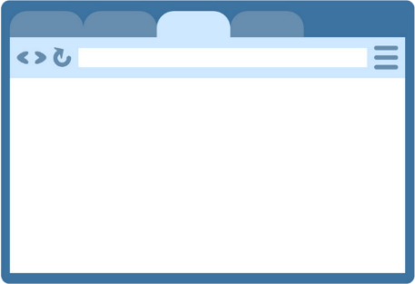




AIMS BUILDER
1 - Web designer uploads image
2 - Image sent to flask server
3 - Server performs object detection and return detected objects
4 - AIMS Builder embeds the extracted message in the carrier image
5 - Annotated image is returned
1
Detected Objects
5
Carrier Image
AIMS Builder
4
Annotated Image
Developer
2
3
Detected Objects
Flask Server

Slide 7
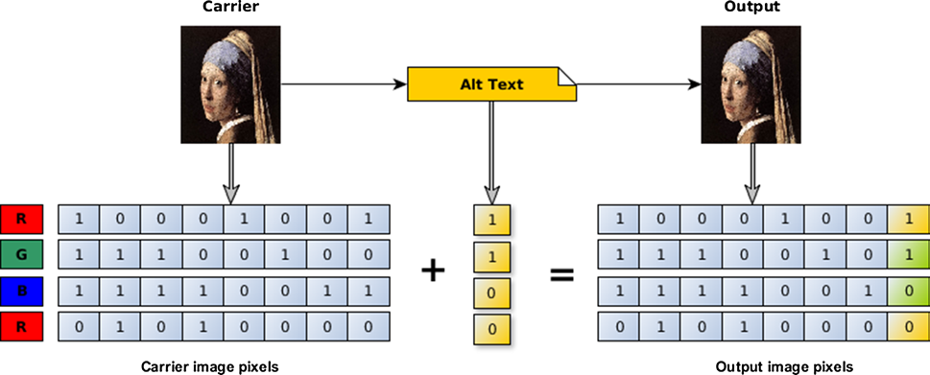
Steganography - LSB
LSB (Least significant Bit )
LSB → Right Most bit
Replaces the right-most bit
i.e. The least significant bit position of randomly selected pixels within the carrier image is replaced by by the message bits
Embedding Algorithm for LSB | Extraction Algorithm for LSB
procedure LSBWrite(carrier img,alt text) C ← carrier img, M ← alt text for i = 1 to len(M) do Compute ij of Cij pixel to store ith bit of M p ← LSB bit of Cij pixel if p! = Mi then Cij ← Mi //Store message bit in LSB return annotated image | procedure LSBRead(carrier img) for i = 1 to len(M) do Compute ij where Mi is stored Mi ← Cij //Get message bit from LSB return alt text

Slide 8



AIMS EXTENSION
1 - VI user surfs the websites
2 - Extension scraps the image URL
3 - The extension extracts the embedded message and the user chosen language is passed to the flask server
4 - Translation is done on the extracted message as per the user preferred language and the result returned back.
5 - Extension set alt attribute to the image tags
1
3
2
AIMS Extension
---------------------------------------------------------------------------------------------------------------------------------------------------------------------------------------------------------------------------------------------------------------------------------------------------------------------------------------------------------------------------------------------------------------------------------------------------------------------------------------------------------------------------------------------
---------------------------------------------------------------------------------------------------------------------------------------------------------------------------------------------------------------------------------------------------------------------------------------------------------------------------------------------------------------------------------------------------------------------------------------------------------------------------------------------------------------------------------------------------------------------------------------------------------------------------------------------------------------------------------------------------------------------------------------------------------------------------------------------------------------------------------------------------------------------------------------------------------------------------------------------------------------------------------------------------------------
------------------------------------------------------------------------------------------------------------------------------------------------------------------------------------------------------------------------------------------------------
5
VI User
4
Flask Server
Browser with AIMS extension installed

Slide 9
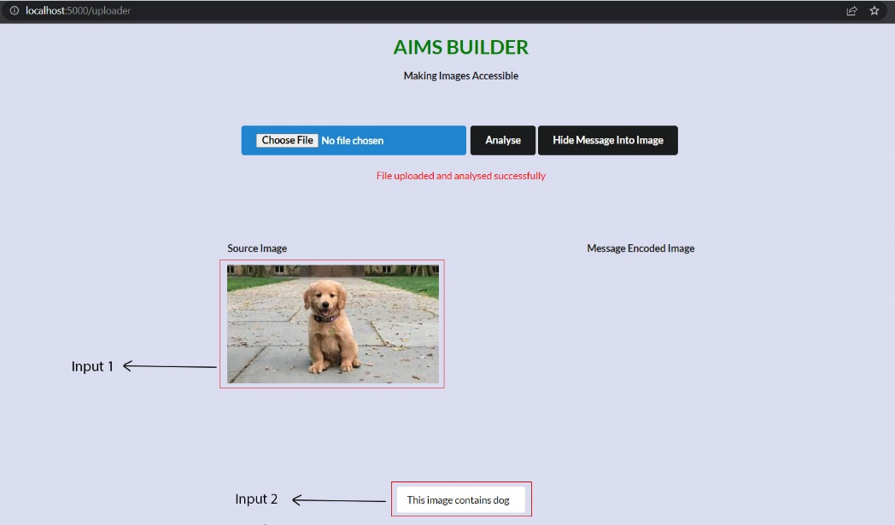
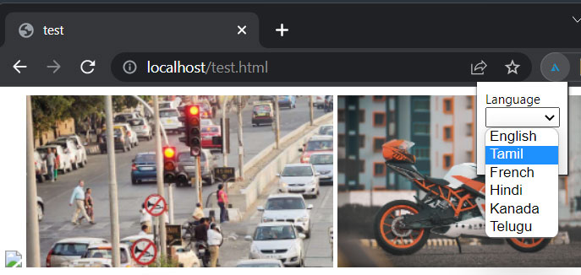
Inputs
AIMS Builder
AIMS builder takes image as input from the web developer.
AIMS builder uses the objects detected as the input.
AIMS Extension
AIMS extension takes the user chosen language as input

Slide 10
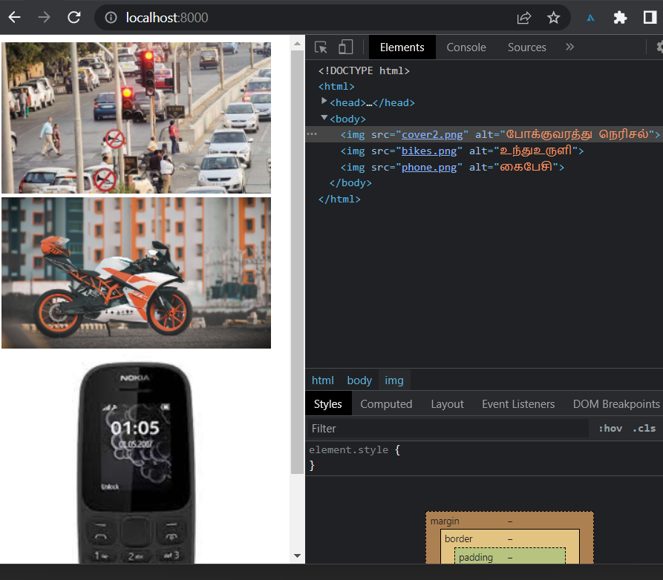
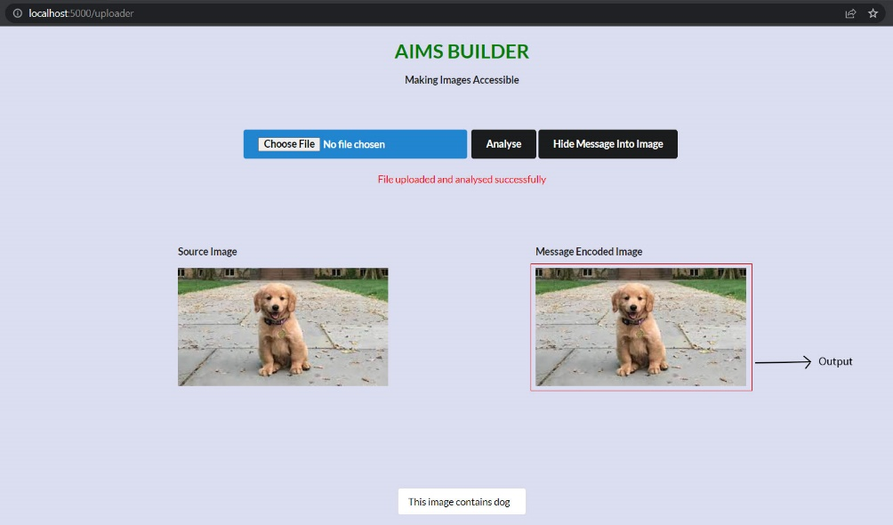
Output
AIMS Builder
AIMS builder embeds the message in the image and returns Annotated image as output
AIMS Extension
AIMS extension updates message description in the alt attribute.

Slide 11
References
Ab Shaqoor Nengroo & K. S. Kuppusamy : Accessible images (AIMS): a model to build self-describing images for assisting screen reader users [2017]
Md Rahman, Md. Mahib Hosen Ornob, et.al : An Effective Text Steganographic Scheme Based on Multilingual Approach for Secure Data Communication [2021]
Salwa Shakir Baawi, Dhamyaa AL-Nasrawi, et.al : Improvement of "Text Steganography Based on Unicode of Characters in Multilingual" by Custom Font with Special Properties Improvement of "Text Steganography Based on Unicode of Characters in Multilingual" by Custom Font with Special Properties [2020]
Park, E., Lim, H.: A study on improvement of evaluation method on web accessibility automatic evaluation tool’s <img> alternative texts based on OCR (2015)
Python Flask Documentation: https://flask.palletsprojects.com/
Chrome extension manifest V2 documentation: https://developer.chrome.com/docs/extensions/mv2/
JavaScript documentation: https://www.w3schools.com/js/DEFAULT.asp

Slide 12
THANK YOU

